Slide 1
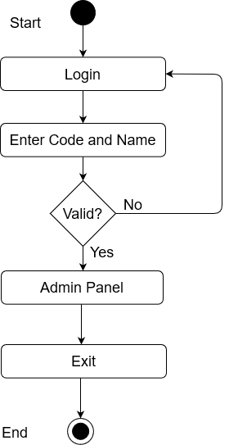
Admin Login

Slide 2
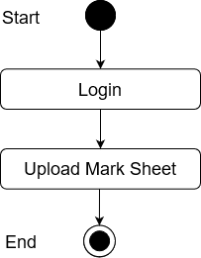
Upload Mark sheet

Slide 3
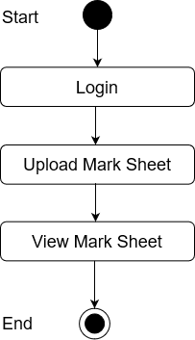
View Mark sheet

Slide 4
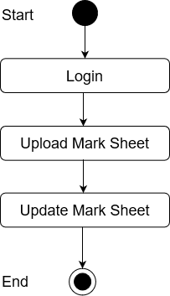
Update Mark sheet

Slide 5
View Mark sheet

Slide 6
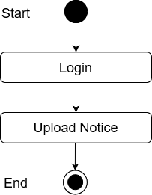
Upload Notice

Slide 7
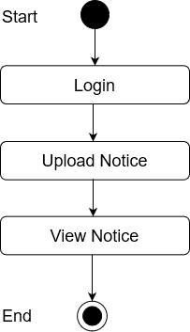
View Notice

Slide 8

Delete Notice

Slide 9
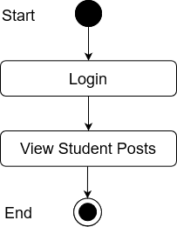
View Student Posts

